Slide 1

BHILAI INSTITUTE OF TECHNOLOGY , DURG (C.G.), 491001
DEPARTMENT OF MECHANICAL ENGINEERING
SESSION: 2020 - 2021
MAJOR PROJECT PRESENTATION
PROJECT GUIDE : Mr. JITENDRA CHAUHAN
BY - AARUSH INGOLE
ADITYA BISEN
SHASHANK SHUKLA
SUMIT SARKAR

Slide 2
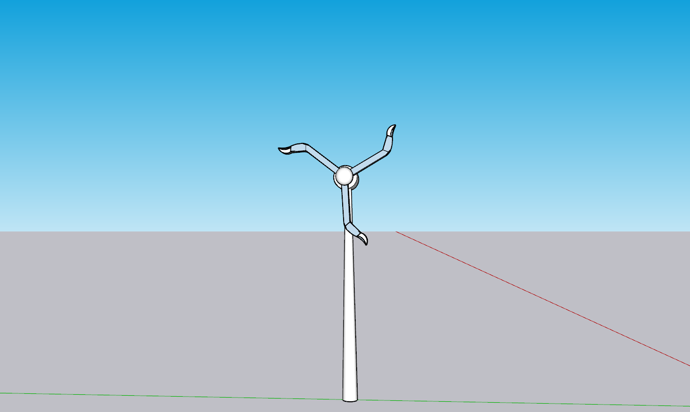
FLOWBELLUM
Analysis of wind turbine inspired turbine rotating due to the weight of its own blade

Slide 3
INTRODUCTION
This project is inspired by wind turbines but this time we are using weight and fluid flow systems in the blades of turbine.
The weight of fluid in the blades will help to produce required torque which will help the blades to rotate.
This turbine doesn’t need any external force like air flow to rotate the rotor.
The planetary gearbox will increase the speed of generator shaft.
Induction generators are used to generate electricity.
These blades rotate at a constant speed.

Slide 4
LITERATURE REVIEW :
After going through several research papers , we got inspired for our project which is based on the idea of improving the efficiency of the windmill. Some of those research papers which were of particular interest are reviewed below:
A self-starting darrieus-type windmill (M.N.Nahas)
A new design concept is proposed for a Darrieus-type windmill in which the straight blades of the rotor are pitched at low values of the tip-speed ratio to make the angle of attack small in order to avoid stall. The new design makes the windmill self-starting, which allows generation of torque and power at low rotational speed. This change eliminates the need for external means of starting and results in an obvious cost advantage. The expected performance of the windmill is analysed in detail and the torque produced and the power coefficient of the new design are compared with those of a conventional Darrieus machine. The effect of geometry on performance has been analysed.

Slide 5
Study on a piezo-windmill for energy harvesting (Junwu Kan)
A piezo-windmill excited by rotating magnets is presented to harvest wind energy.
Excitation force exerting on piezo-windmill is general periodic instead of harmonic.
Analytical model of evaluating piezo-windmill under general periodic force is built.
There are multiple optimal wind-speed ranges for the amplitude ratio to achieve peak.The influence of the number of exciting magnets on the piezo-windmill is obtained.
Multiscale Analysis of Wind Velocity, Power Output and Rotation of a Windmill(Olmo Duran)
There is growing efforts for the development of wind energy. Yet, as for other renewable resources, a basic characteristic of wind energy is to deliver intermittent power. In this paper, they considered this topic by analyzing data provided by the wind industry. They discussed first the spectral properties of the data and the corresponding power curve. They estimated the scaling behavior in the inertial scale of wind input and the power output. They also studied the rotor revolution scaling fluctuations.

Slide 6
Design of wind turbine blade material for higher efficiency (K.P.M.T.V.Dathu)
Recently windmills are drastically increasing to generate electricity. Currently, windmill blade materials using for windmills are polyester, glass fiber, carbon fiber, the combination of fiber with other materials, reinforcing the epoxy material on the blade.
To get greater efficiency the weight of the blade should decrease, so replacing the blade material with lightweight materials and adding different materials like Nickel-Titanium (Ni-Ti), Copper-Aluminium-Nickel (Cu-Al-Ni), Copper-Zinc-Aluminium (Cu-Zn-Ai) to increase the efficiency of the wind turbine and to get higher strength.
The example implementation of new material that is compared with conventional materials & checking the efficiency. In this paper, the implementation of efficiency by mixing new materials is analyzed.

Slide 7
PROBLEM IDENTIFICATION
The problems with the current model of a wind turbine are :
The wind is inconsistent.
Installation can take up a significant portion of land.
Wind turbines are suited to a particular region only.

Slide 8
PRINCIPLE
The force exerted here is due to the weight of the fluid and the blade. When a blade initially on right side completes half of its motion then the torque exerted in that part or left is less than compared to the other half (which is the right one).The blade will be designed in such a way that the fluid will flow inwards during its motion towards the left, this will create an imbalance of weight generating torque in the blades or turbine.

Slide 9
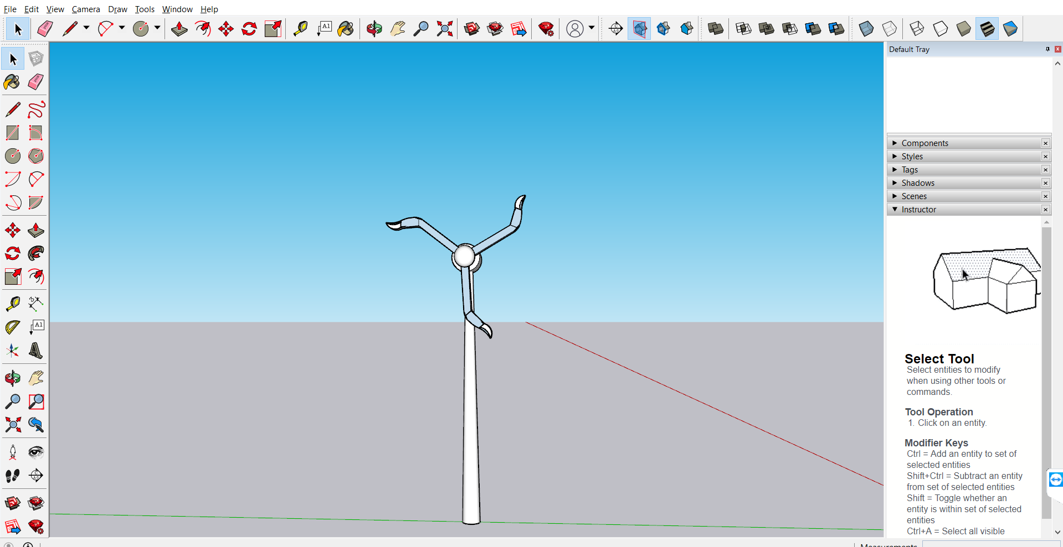
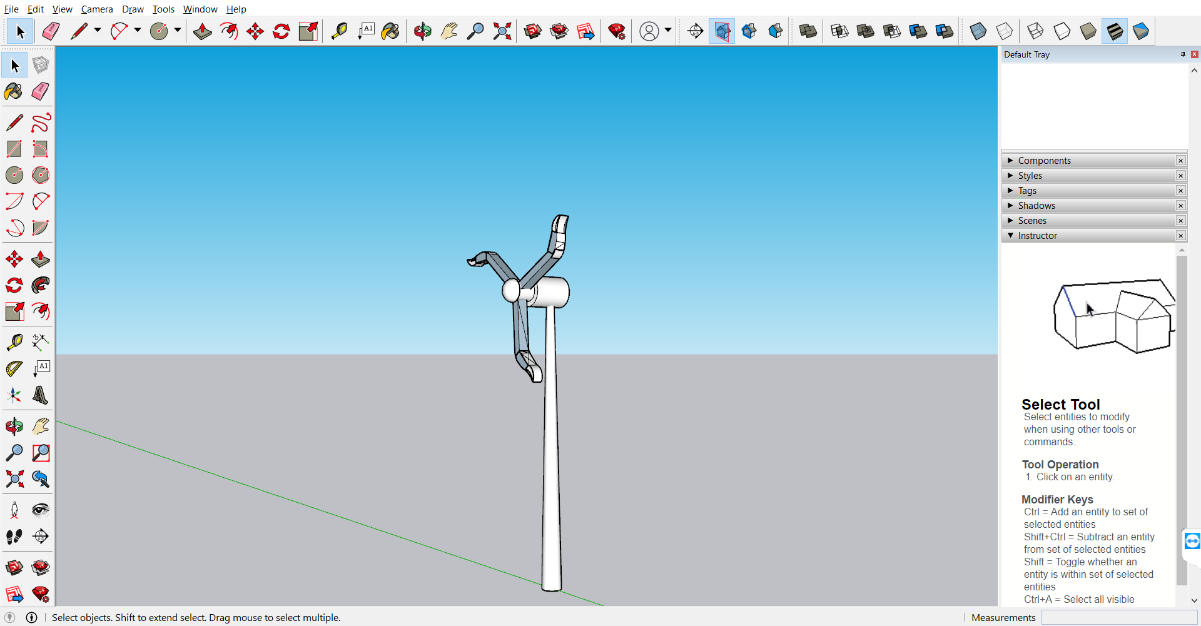
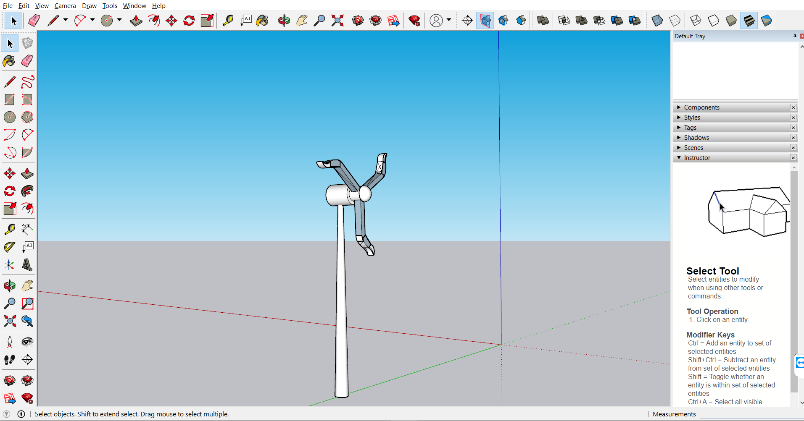
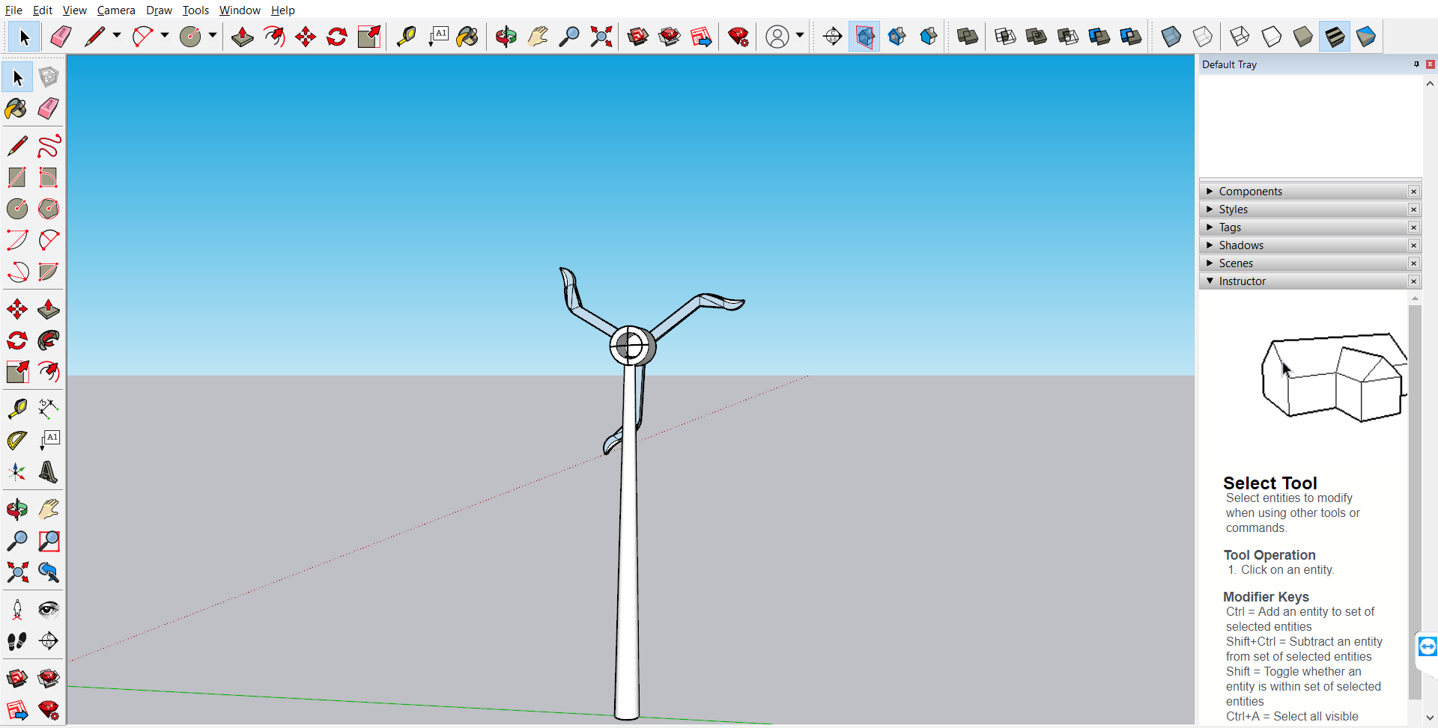

Slide 10
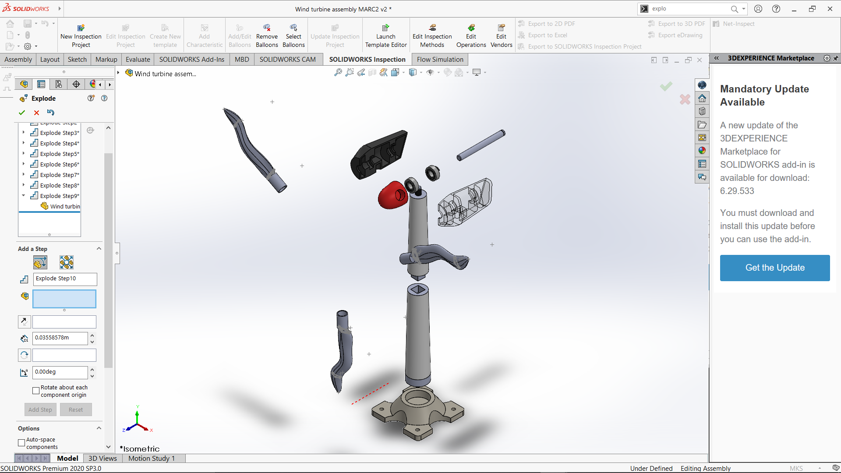
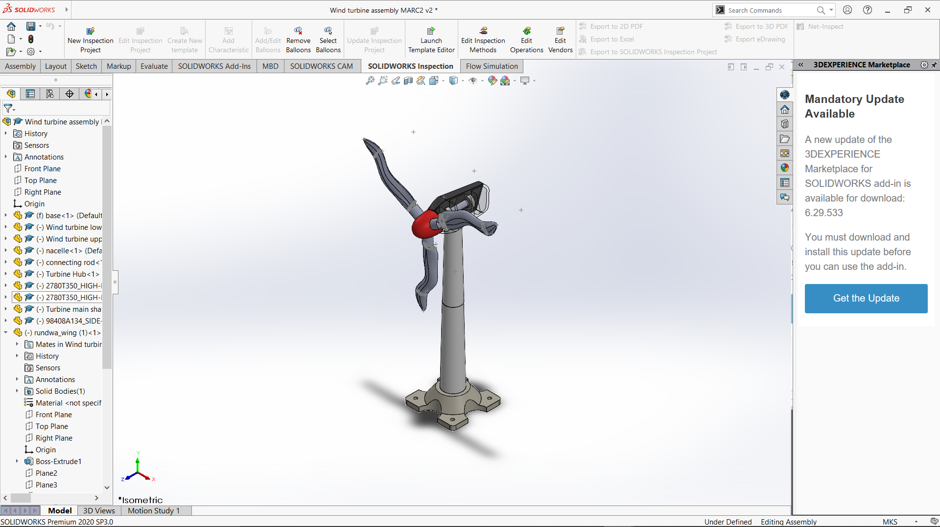

Slide 11
BLADES WORKING - I
There are three blades which are made up of carbon fiber reinforced plastics which are of total 10 m in length.
The blade is divided into two parts : First one is the straight part and its length is 7m.
The second portion of the blade is the bent one which is 3 m in length and makes an angle greater than 45°(>45°) with the straight part (7 m).
The hollow part inside the blade is used to create a path to allow the fluid to flow back and forth.When the whole rotor starts to move in clockwise direction it creates torque due to the greater weight on one side of the blade.

Slide 12
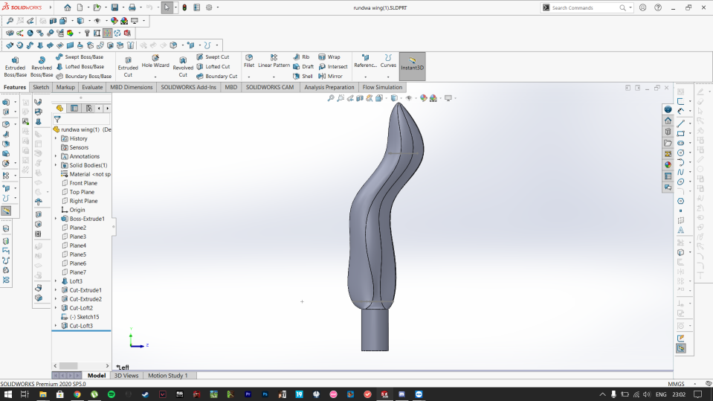
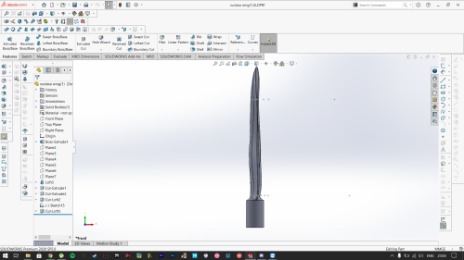
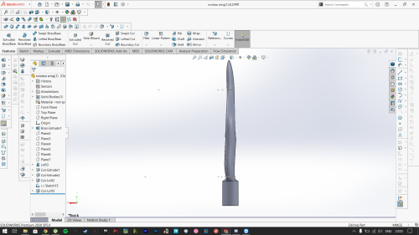

Slide 13
BLADES WORKING - II
The fluid inside the blades also starts moving .The fluid inside the blade which was initially at the end of the blade starts moving in inward direction opposing the centrifugal force due to the bent in the blades.
This process continues and provides a constant angular velocity to the rotor which is connected to the gearbox.Inside the planetary gearbox the gears rotate which increases the velocity of the generator shaft.
Thus the generator shaft will rotate in a high speed which will help the generator to produce electricity.

Slide 14
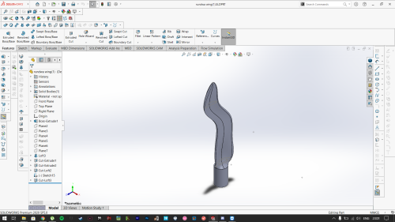
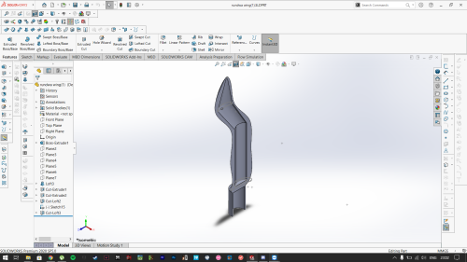

Slide 15
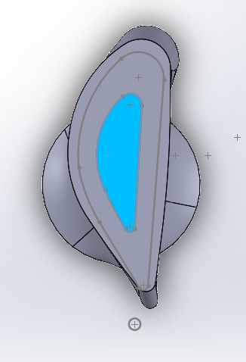
BLADES WORKING - III
The imaginary cross section of each region from root to tip of the blade is called airfoil.
The airflow through an airfoil is distributed unevenly and produces forces on the airfoil surface. The lift force is obtained when there is a pressure difference of the air between upper surface region and the lower surface region of an airfoil, and it is perpendicular to the relative wind flow. Drag force is the parallel to flow direction, and it is also created form unequal pressure on the airfoil surfaces facing forward and away from the oncoming flow. Both lift and drag forces result the thrust and torque to the system and their ratio defines one of the key characteristics of an airfoil. The lift force is a beneficial force which needs to be increased, and the drag force needs to be as much as smaller in order to get high lift to drag ratio.

Slide 16
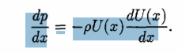
An annular ring is created when a blade element is swept in the axial direction of the blade while the blade rotates. If two dimensional airfoil characteristics along with an angle of attack calculation are utilized, then the forces present on this blade element can be calculated.
The profile is then constructed so that the velocity at the edge of the boundary layer U(x) is constant after the acceleration past the leading edge and downstream. It is known from boundary layer theory, that the pressure gradient is expressed by the velocity outside the boundary layer
The inner cross section given (in blue) is the hollow structure inside the blade. This is the structure where the water will flow . The outer structure is given an airfoil shape as the need to harness the outside windflow . The flow of the water in inner structure will provide an additional torque as shown in the previous slides . So all in all wind comes ,water flows ,rotor rotates , energy is produced.

Slide 17
PLANETARY GEARBOX
A typical gearbox design for a 2 MW machine has one planetary stage and two parallel stages (Figure 1). The planetary stage has two planetary carrier bearings and 9 cylindrical planetary bearings (Figure 2). The two parallel stages have in total three shafts where each shaft has one cylindrical roller bearing and two tapered roller bearings for shaft axial load and guiding. The gearbox has in total 20 bearings and 9 gear wheels.

Slide 18
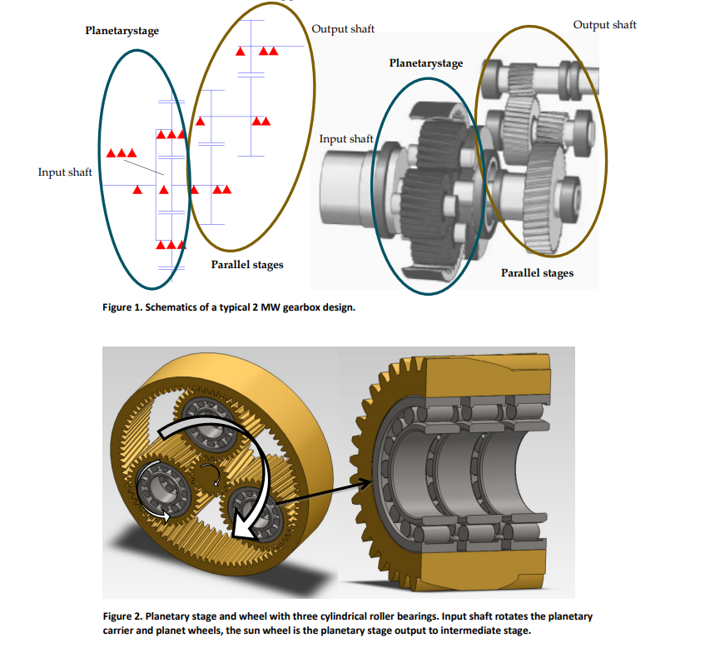

Slide 19
INDUCTION GENERATOR
It is a type of AC electrical generator with principle of operation similar to an Induction motor, only difference being that it runs at super-synchronous speed, thereby converting the input mechanical energy from the prime mover as electrical energy at the output.
It has two components-
a) Stator
b) Rotor
The stator itself is fixed, while the flux produced due to the three phase windings rotates at a speed called the synchronous speed Ns.
The rotor is the movable part of the machine and the speed at which it rotates is called mechanical speed Nm. The ratio of difference between synchronous and mechanical speed to the synchronous speed is termed as slip s.

Slide 20
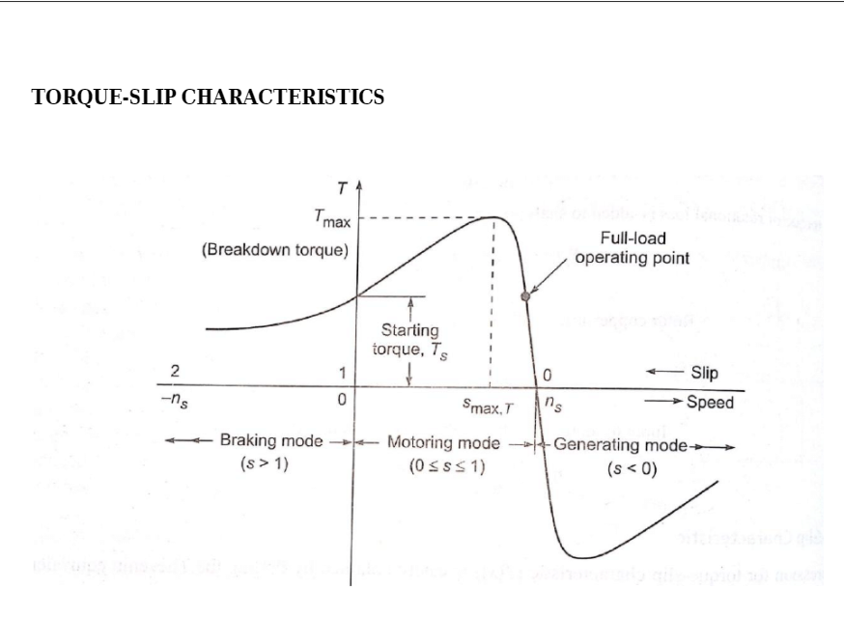

Slide 21
The graph clearly shows that for generating mode, the slip s is negative. The generating region is pretty similar to the motoring region, but the curve of the generating mode is just inverted version of that of the motoring mode i.e. the locus points of the generating mode are negative of that of the motoring mode. The three types of Induction generators used in wind power generation are:-
i. Squirrel Cage Induction Generator (SCIG)
ii. Wound Rotor Induction Generator (WRIG)
iii. Doubly Fed Induction Generator (DFIG)

Slide 22
RESULT ANALYSIS
EXTERNAL ANALYSIS
Goal | Unit | Value | Average value | Minimum value | Maximum value | Delta
GG Torque (X) | [N*m] | 1.369e-05 | 1.332e-05 | 0.035 | 0.174 0 | 0.139
GG Torque (Y) | [N*m] | 4.468e-05 | 4.449e-05 | 0.021 | 0.019 0 | 0.002
SG Force (X) | [N] | 1.926e-06 | 4.061e-05 | 2.717 | 4.286 0 | 1.569
The values we obtained for the external air flow(10 m/s) through the wind turbine , it indicates the max and min torque generated in the rotor due to the lift force and the min and max value of drag force and also the value of velocity RRF.

Slide 23
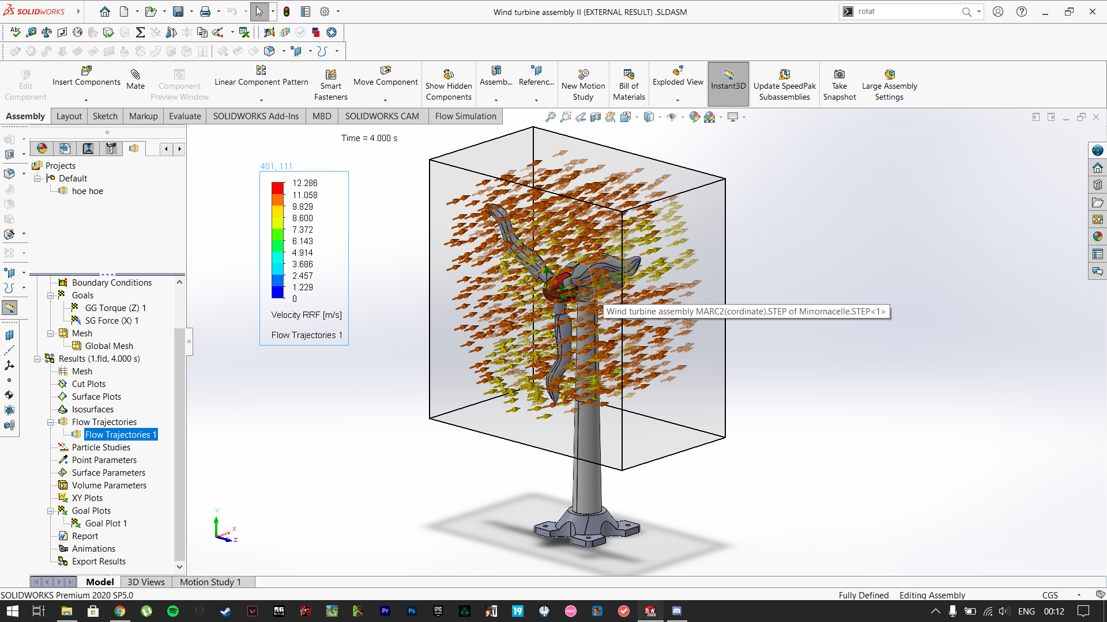

Slide 24
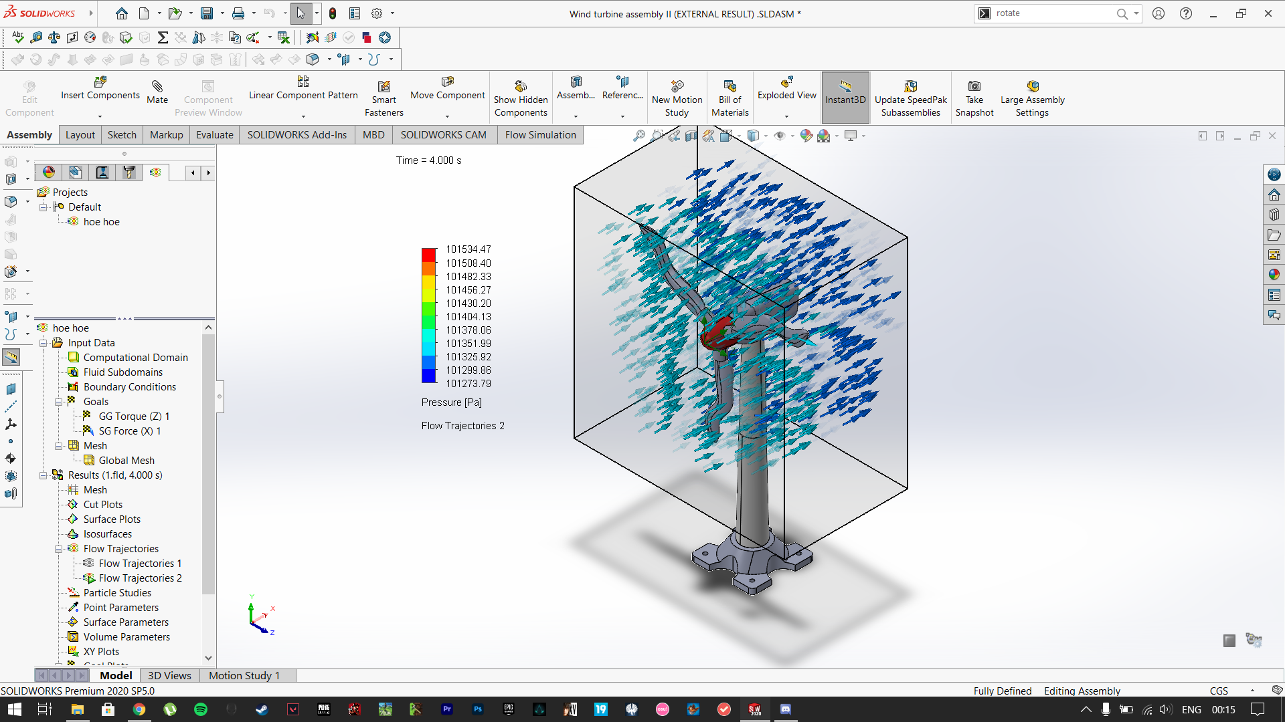

Slide 25
INTERNAL ANALYSIS
Goal | Unit | Value | Average value | Minimum value | Maximum value | Delta
GG Torque (X) | [N*m] | 1.373e-05 | 1.333e-05 | 0.035 | 0.174 0 | 0.175 0
SG Force (X) | [N] | 1.495e-06 | 4.064e-05 | 2.716 | 4.286 0 | 4.240 0
The fluid flowing inside generates the upgiven torque. This proves the rotation of the rotor in the clockwise direction.

Slide 26
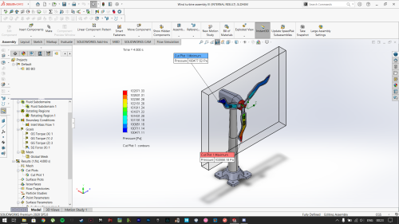
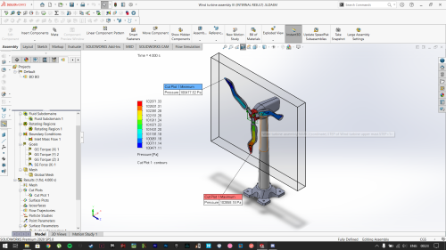
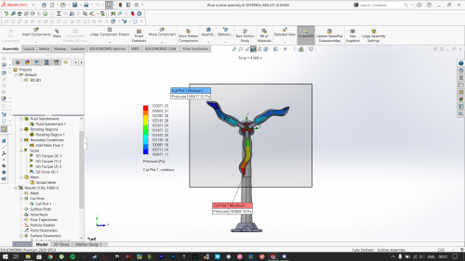
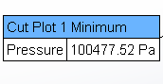
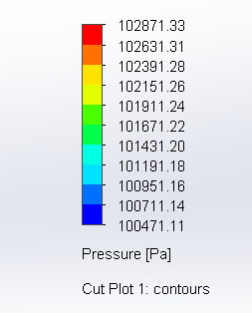
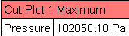

Slide 27
CONCLUSION
The main disadvantage of the conventional wind turbine was the unpredicted speed of wind current, therefore the constant rotation cannot be expected.Therefore the constant output cannot be produced.
The weight of a body on the other hand is constant in nature.So we thought of using the weight of the body itself to rotate the turbine. In this way the rotation speed can be predicted to be constant and further measures could be taken to increase the speed and the output of the turbine. The planetary gearbox will then help to increase the speed for the process of generation of electricity.
The simulation of the model is done in Solidworks from which we concluded the successful rotation of turbine. The advantage of this turbine is that it can be implanted to any place regardless of the neccessity of hing wind speed. This will add to renewable sources of energy which are the key part in the fight against the climate change and global warming. Surely as students of this generation it’s our responsibility to bring the change and this is our contribution towards it.

Slide 28
REFERENCE
WWW.YOUTUBE.COM
Winglet Design and Analysis for Wind Turbine Report - Rinaldo Gonzalez,Galdamez Diego Moreno, Ferguson Juancarlo ,Rodriguez Gutierre.
Multiscale Analysis of Wind Velocity, Power Output and Rotation of a Windmill(Olmo Duran)
A self-starting darrieus-type windmill (M.N.Nahas)

Slide 29
THANK YOU!

